Slide 1
Automation of Social Work BPSS Assessment Using a Hybrid BERT and GPT Model
Name: Xianqing Zeng
Advisor: Prof Yi-Chieh Lee
Department of Computer Science
School of Computing
National University of Singapore
24/04/2024

Slide 2
Contents
Introduction
Background
Research Methods and Design
Experimental Design and Evaluation
Results Analysis and Discussion
Conclusion and Future Work

Slide 3
Introduction
NLP’s growing importance in social work area
Assist social workers in understanding and predicting individual needs and emotional states through text data analysis.
Generative Artificial Intelligence (GAI) models and Large Language Models (LLM) are considered to have the potential to support safe and ethical social work decisions.
ChatGPT has demonstrated above-average performance in assessments within the social work field.
Generative dialogue systems, such as chatbots, can simulate daily conversations by social workers, providing preliminary mental health support and crisis intervention.

Slide 4
Introduction
Current Challenges
An comprehensive analysis of the conversation with respect to BPSS models could help ChatGPT better understand user’s situation
Having daily conversation taken by the chatbots can have the negative impact that social workers not being able to keep up with residents’ situation in time
Limitations in existing BPSS methods: time-consuming and often inaccurate.

Slide 5
Introduction
Research Objectives：
Aimed at exploring the potential applications of BERT and GPT models in automated BPSS assessments
Analyzing and validating the application potential of BERT and GPT models in social work BPSS assessments.
Designing and implementing an application framework for BPSS assessment based on a hybrid model of BERT and GPT.
Through experimental research, evaluating the effectiveness of this hybrid model in social work BPSS assessments, providing technical support and theoretical basis for social work practice.

Slide 6
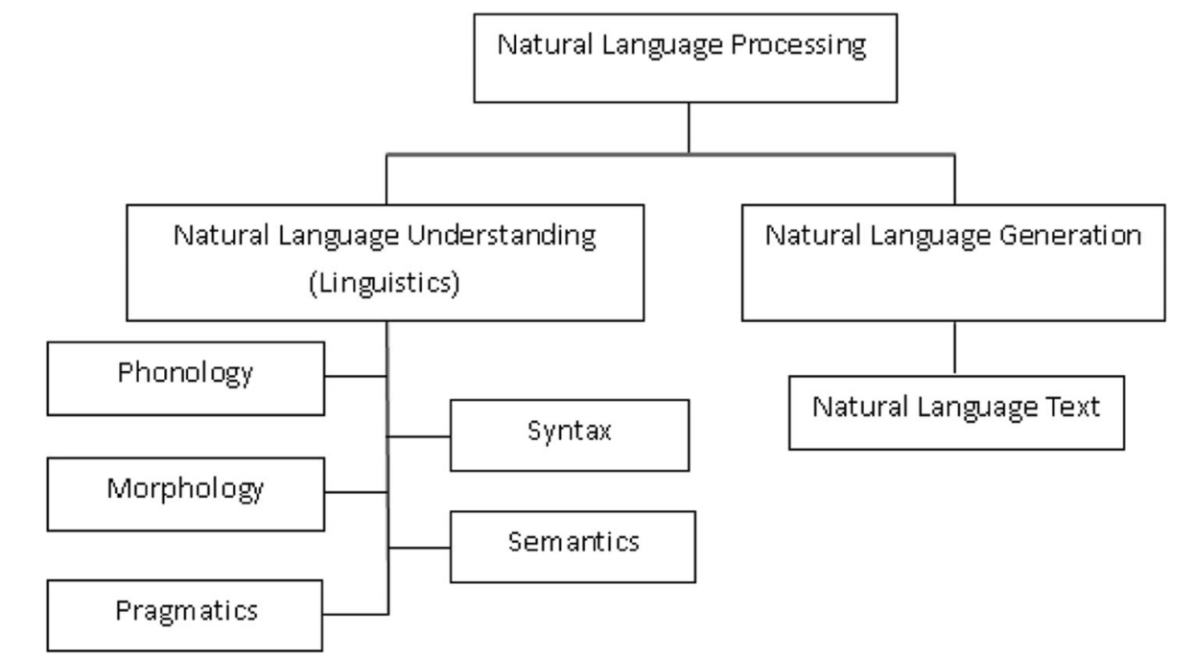
Background
Natural Language Processing (NLP)
Natural Language Understanding (NLU)
Analyzing counseling records and social media to quickly identify individual needs
Assisting in document classification and information extraction^{[1]}
Natural Language Generation (NLG)
Enhances communication efficiency and management operations
Chatbots provide instant and natural responses, case documentation, and report generation ^{[2]}
[1] KHURANA D, KOLI A, KHATTER K, et al. Natural language processing: State of the art, current trends and challenges[J]. Multimedia tools and applications, 2023, 82(3): 3713-3744.
[2] CHEUNG S L, CHIN E, CHUA E C, et al. A Bio-Psychosocial-Spiritual Assessment Guide for Health and Social Work[A/OL]. Singapore Association of Social Workers (SASW). 2023. https://sasw.org.sg/wp-content/uploads/2023/02/A-Bio-Psychosocial-Spiritual-Assessment-Guide-for-Health-and-Social-Work.pdf.

Slide 7
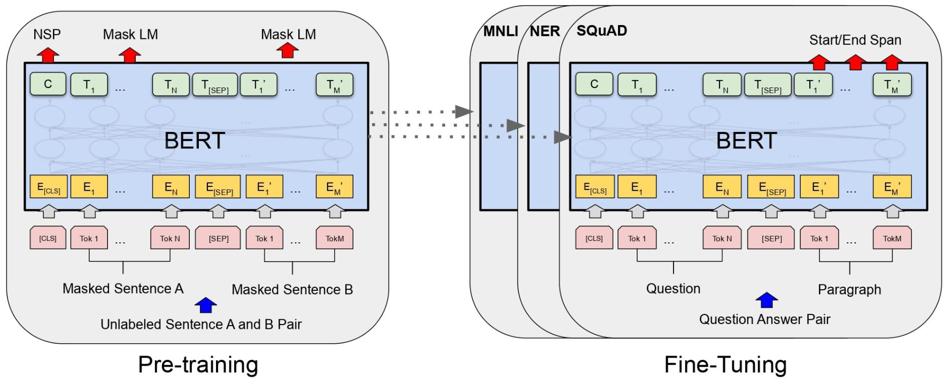
Background
BERT (Bidirectional Encoder Representations from Transformers)^{[1]}
Google AI's bidirectional training model comprehensively understands the context of text,
Significantly enhancing the performance of NLU tasks (e.g. text classification, entity recognition, and question-answering systems)
Extensive pre-training learns rich language knowledge, efficiently transferring learning to downstream tasks.
Excels in handling complex texts and long-distance dependencies, making it a core technology in the NLU field
[1] DEVLIN J, CHANG M W, LEE K, et al. Bert: Pre-training of deep bidirectional transformers for language understanding[J]. arXiv preprint arXiv:1810.04805, 2018.

Slide 8
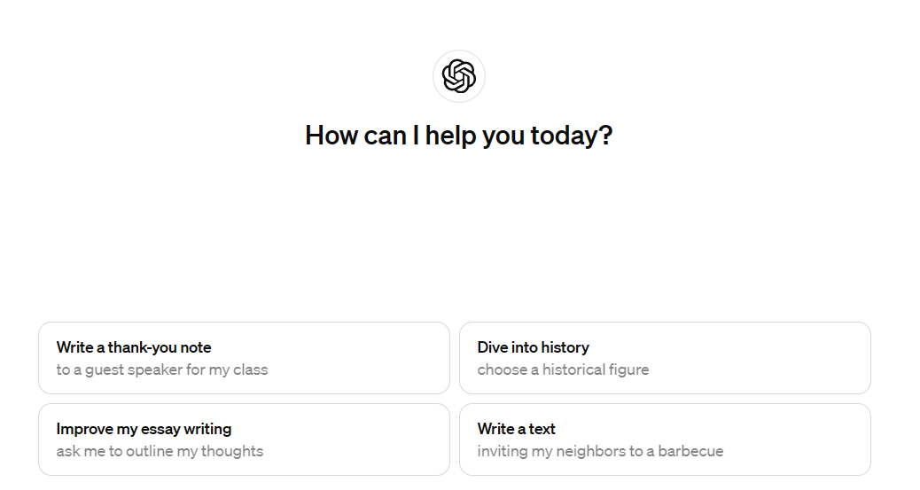
Background
GPT（Generative Pre-trained Transformer）
OpenAI's advanced dialogue generation system optimizes coherent, diversified text generation.
Trained on a wide range of data, enabling the understanding and generation of multi-style, multi-themed texts.
Generates coherent, logical responses, enhancing the naturalness of human-computer interaction and maintaining consistency in multi-turn dialogues.
Facilitates the creation of stories, articles, creative texts, and promotes the automatic generation of reports and educational materials.

Slide 9
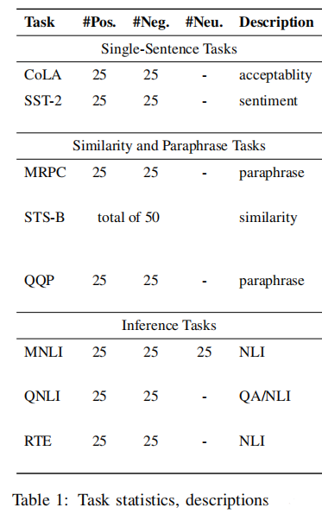
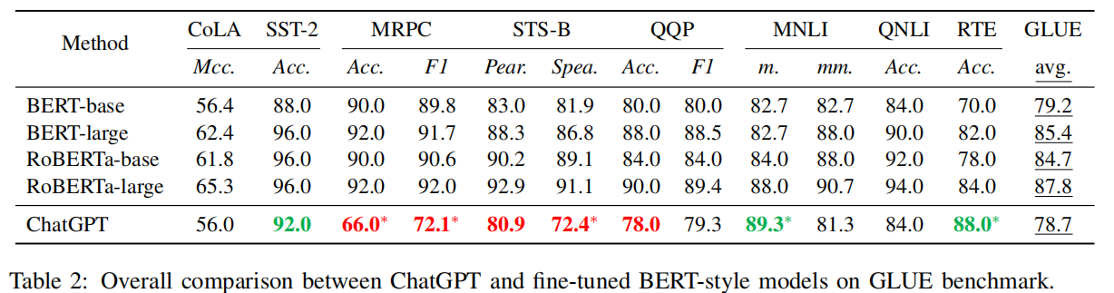
Background
BERT: Effective in tasks like sentiment analysis, language acceptability judgments, and natural language inference
ChatGPT: Excels in complex generation and dialogue tasks, surpassing BERT in some reasoning tasks
Hybrid Use: Combines BERT’s precise text classification with ChatGPT’s generative excellence for automated social work assessments^{[1]}
[1] Zhong, Q., Ding, L., Liu, J., Du, B., & Tao, D. (2023). Can chatgpt understand too? a comparative study on chatgpt and fine-tuned bert. arXiv preprint arXiv:2302.10198.

Slide 10
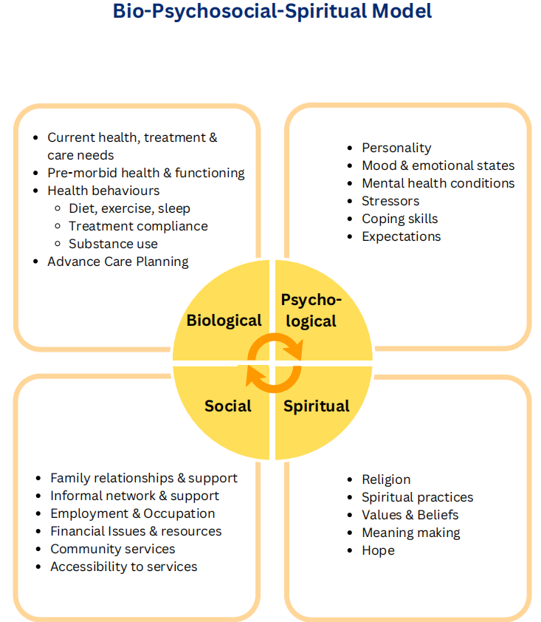
Background
Bio-psycho-socio-spiritual (BPSS) model^{[1]}
Advantage
Covers biological, psychological, social and spiritual dimensions to achieve a comprehensive assessment of individuals
Helps social workers to identify the multi-dimensional needs of service clients and formulate precise intervention plans
Improve the quality and effectiveness of social work services through a deep understanding of individual circumstances
Challenge
Traditional manual evaluation methods are time-consuming, inefficient and susceptible to subjective factors
Urgent need for efficient and accurate automated BPSS assessment tools in the field of social work
[1] CHEUNG S L, CHIN E, CHUA E C, et al. A Bio-Psychosocial-Spiritual Assessment Guide for Health and Social Work[A/OL]. Singapore Association of Social Workers (SASW). 2023. https://sasw.org.sg/wp-content/uploads/2023/02/A-Bio-Psychosocial-Spiritual-Assessment-Guide-for-Health-and-Social-Work.pdf.

Slide 11
Research Methods and Design
Methods
Apply BERT's text classification with ChatGPT's generation capabilities to automate the construction of BPSS model outlines.
Step 1: Use ChatGPT to rewrite conversations, streamline information, and preserve important details.
Step 2: BERT classifies the text and identifies BPSS related content.
Step 3: Based on classification, ChatGPT generates a structured overview to deepen case understanding.
Objective: To improve the efficiency and accuracy of social work evaluation and respond quickly to individual needs

Slide 12
Experimental Design and Evaluation
Selection and Validation of Classification Models
Verify the applicability of BERT and GPT model combination in BPSS evaluation, and determine the best text classification strategy.
Steps
Data preparation: Acquisition and preprocessing of the Count-Chat dataset^{[1]}, including cleaning and sentence processing.
Manual labeling: 400+ sentences were labeled biological (B), psychological and spiritual (P), social (S), and uncategorized (N)
ChatGPT annotation: Use ChatGPT predictive tags, and then manually verify the correction to ensure data quality
BERT fine-tuning: Fine-tuning the BERT model for BPSS classification, adjusting parameters to optimize performance
Performance evaluation: Compare ChatGPT and fine-tune BERT in BPSS classification accuracy, recall rate and F1 score.
[1] BERTAGNOLLI N. Counsel-Chat Dataset[Z]. https://huggingface.co/datasets/nbertagnolli/counsel-chat. 2021.

Slide 13


Experimental Design and Evaluation
Selection and Validation of Classification Models
Counsel-chat
Dataset
Manual Labeling
(Coarse/Fined grained)
Fine-tuned BERT Models for distinct domains
Sentence Segmentation
Fine-tune
Split
Test Dataset
Labeled Sentences
Predict
Accuracy
Recall
F1 Score
Compare
Resultes
Labeled Sentences
Prompt Engineering
& Predict

Slide 14
Experimental Design and Evaluation
Method Implementation and Generation Process
Dialogue Rewriting
Data Preparation and Preprocessing
BERT Fine-Tuning
ChatGPT Training and Generation
Evaluation and Comparison

Slide 15
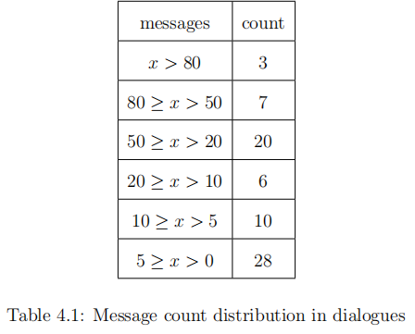
Experimental Design and Evaluation
Counsel-chat
Dataset
Manual Labeling
(Coarse/Fined grained)
Fine-tuned BERT Models for distinct domains
Sentence Segmentation
Fine-tune
Chat Messages
Top 3 of
each level
First-person
Narrative
Classify by
message count
Rewriting
Segment
&
Predict
Structured
BPSS Model
Classified
Sentences
Prompt
Engineering

Slide 16
Results Analysis and Discussion
Consistency Assessment of Manually Annotated Dataset
Overview of Manual Annotation
Over 400 preprocessed sentences precisely categorized.
Categories include Biological (B), Psychological/Psychiatric (P), Social (S), and Non-relevant (N).
Follows strict principles and the BPSS model to ensure high-quality data.
Importance of Inter-Rater Reliability (IRR)
Measures consistency among different raters in scoring/classification tasks.
Cohen's Kappa used as a statistical tool, ranging from -1 (no agreement) to 1 (perfect agreement).

Slide 17
Results Analysis and Discussion
Consistency Assessment of Manually Annotated Dataset
Findings on Consistency
Cohen's Kappa for main domain labels: 0.3365 (moderate agreement).
Cohen's Kappa for sub-domain labels under consistent main labels (excluding 'N'): 0.2454 (lower agreement).
Implications and Future Improvement
Results confirm process consistency but highlight need for further standardization and rater training.
Emphasizes enhancing annotation guidelines and conducting detailed consistency checks for future projects.

Slide 18
Results Analysis and Discussion
Coarse Classification Model Performance Comparison and Analysis
Compare BERT and ChatGPT4-Turbo in classifying texts into Biological (B), Psychological/Spiritual (P), Social (S), or None (N).
Split Ratio: 80% training, 10% validation, 10% test sets to evaluate model generalization.
Model Configurations: BERT-Base-Uncased vs ChatGPT4-Turbo

Slide 19
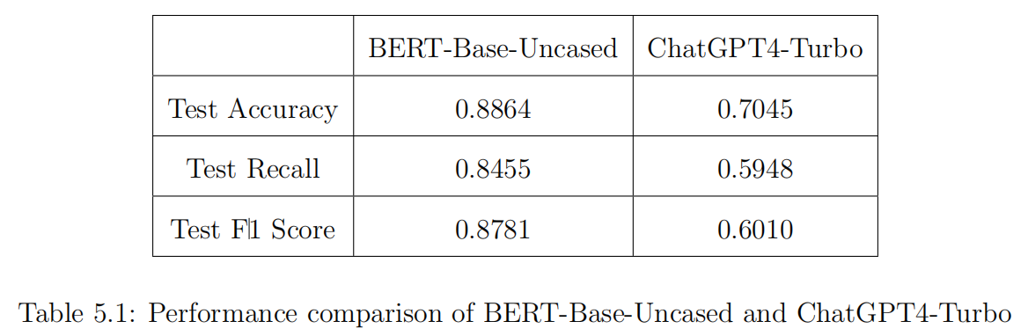
Results Analysis and Discussion
Coarse Classification Model Performance Comparison and Analysis
BERT outperforms ChatGPT4-Turbo significantly in accuracy, recall, and F1 score.
Demonstrates stronger generalization ability on unseen data, making it more suitable for BPSS classification tasks.

Slide 20
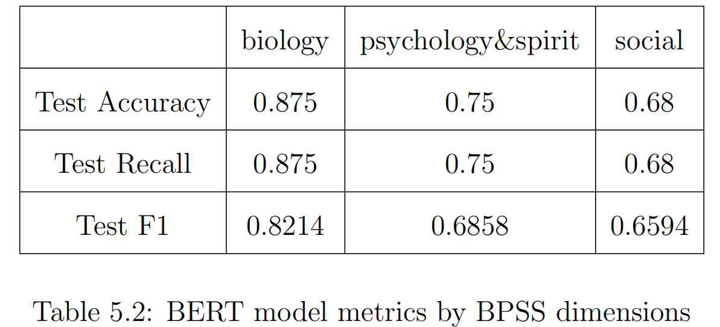
Results Analysis and Discussion
Fine-Tuning BERT Model for Detailed Classification Analysis
Enhance automated BPSS assessments through refined classification of Biological, Psychological & Spiritual, and Social categories.
Results by Category:
Biology: High accuracy and recall (0.875), F1 score (0.8214).
Psychology & Spirit: Moderate accuracy and recall (0.75), F1 score (0.6858).
Social: Lower performance, accuracy and recall (0.68), F1 score (0.6594).

Slide 21
Results Analysis and Discussion
Fine-Tuning BERT Model for Detailed Classification Analysis
Challenges Encountered
Complexity in Psychological & Social Categories: Diverse and complex concepts increase classification difficulty.
Dataset Limitations: Small size and potential imbalances impact learning effectiveness.
Annotation Quality: Subjective judgments among annotators lead to inconsistent quality, affecting model performance.
Future Directions
Expand and optimize the training dataset.
Improve data annotation quality.
Optimize model structure and parameters.
Explore new methods incorporating more contextual information and model interpretability for complex categories.

Slide 22
Results Analysis and Discussion
BPSS Scenario Overview Quality Assessment
Comparative analysis of generated content: fine-tuned/classified by BERT (with ChatGPT) vs. original texts (with GPT).
Uses Coh-Metrix indices to assess quality in textual accuracy, consistency, and semantic relevance.
Quality Metrics Used
Textual Accuracy: Includes narrativity, word concreteness, and noun overlap.
Consistency: Covers referential cohesion, deep cohesion, connectivity, and content word overlap.
Semantic Relevance: Assesses semantic coherence, verb overlap, lexical embedding depth, and passive voice density.
Coh-Metrix^{[1]}: Framework for evaluating NLP and text generation quality.
[1] McNamara, D. S., Graesser, A. C., McCarthy, P. M., & Cai, Z. (2014). Automated evaluation of text and discourse with Coh-Metrix. Cambridge University Press.

Slide 23
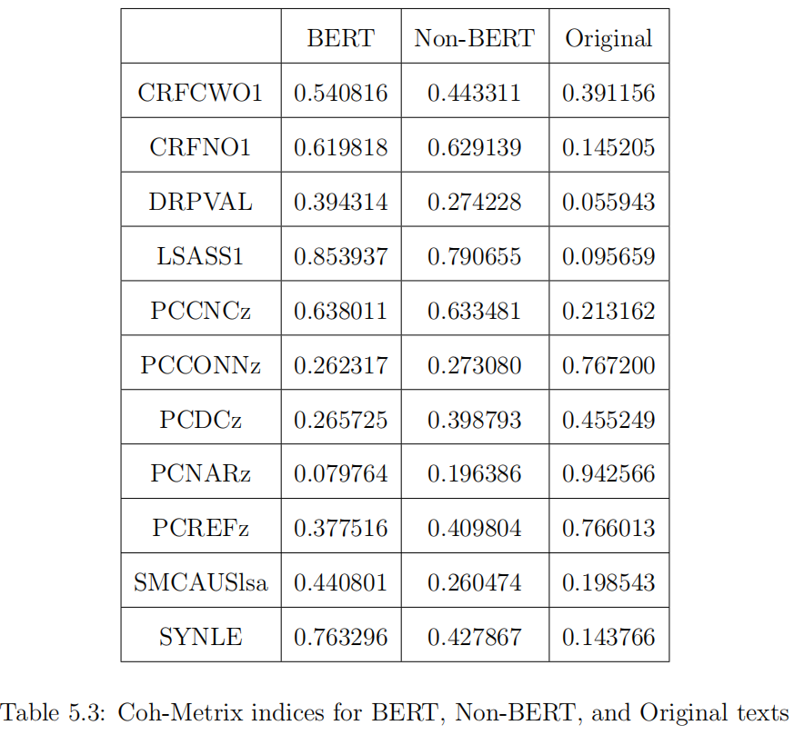
Results Analysis and Discussion
BPSS Scenario Overview Quality Assessment

Slide 24
Results Analysis and Discussion
BPSS Scenario Overview Quality Assessment
Enhanced Textual Precision
Word Concreteness & Noun Overlap: BERT processing selects more specific vocabulary and emphasizes key nouns, leading to improved textual precision.
Loss in Narrativity: The refined focus results in a decrease in the original narrative structure's completeness.
Improved Consistency
Cohesion & Connectivity: While the original text maintains higher overall connectivity and cohesion, BERT-processed texts show improvement over unprocessed versions, enhancing thematic coherence and logical structure consistency.
Increased Semantic Relevance
Semantic Overlap & Structural Complexity: BERT enhances semantic consistency between sentences and refines sentence structures, which are crucial for complex text generation tasks.

Slide 25
Conclusion and Future Work
Summary and Main Findings:
Improved Efficiency & Accuracy
Combines BERT's text classification with GPT's summary generation.
Delivers faster, more precise evaluations of clients' BPSS (Biopsychosocial) states.
Methodological Innovation
Innovative, automated approach utilizing the synergistic capabilities of BERT and GPT.
Offers dynamic, nuanced assessments beyond traditional static methods.
Empirical Validation
Tested with real-world data from social work interactions.
Proven effective in practical settings, enhancing BPSS assessment quality in social work.

Slide 26
Conclusion and Future Work
Future Research Directions
Daily Social Work Practices
Regular use in various settings to streamline BPSS assessments.
Reduces paperwork, allows more time for direct client care.
Use in Crisis Situations
Provides rapid assessments for swift decision-making.
Aids in quick formulation of intervention strategies.
Training and Education
Serves as an educational tool in training programs.
Simulates real-life scenarios to teach complex assessment processes.
Research in Social Sciences
Analyzes communication patterns and interactions.
Contributes to both academic research and practical methodologies.

Slide 27
Thank you for listening

